Slide 1


Building a Javascript User Interface in Drupal 7 to control Flowplayer
Presented by Paul Preibisch
fire@b3dmultitech.com
Twitter: @fire

Slide 2

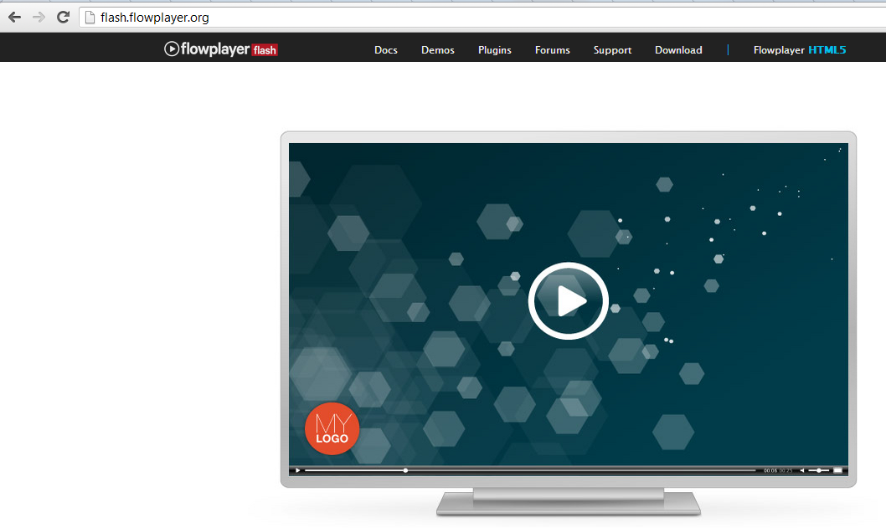
Flowplayer Flash
http://flash.flowplayer.org/
Powerful API
$f().seek(100);
$f().play();
$f().stop();
$f().onCaption
Powerful Flash Plugins
Captions plugin
Content plugin
Controls Plugin
Youtube Plugin

Slide 3
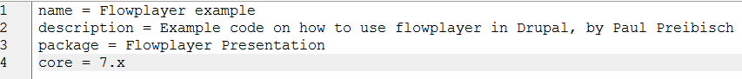
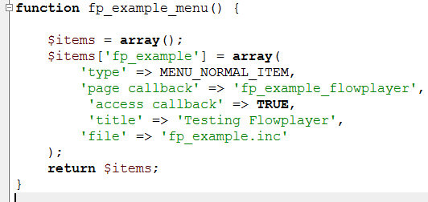
1) Let’s create a simple custom module!
Define module
fp_example.info
fp_example.module
Create Menu Item Callback

Slide 4
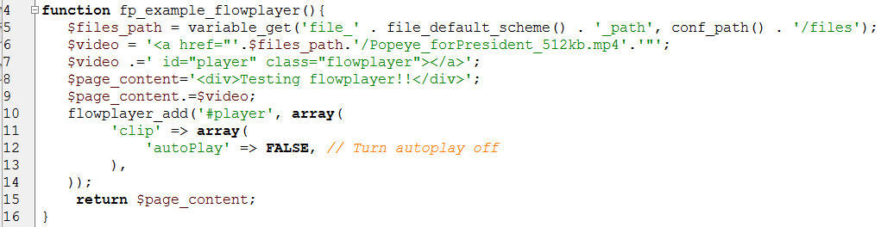
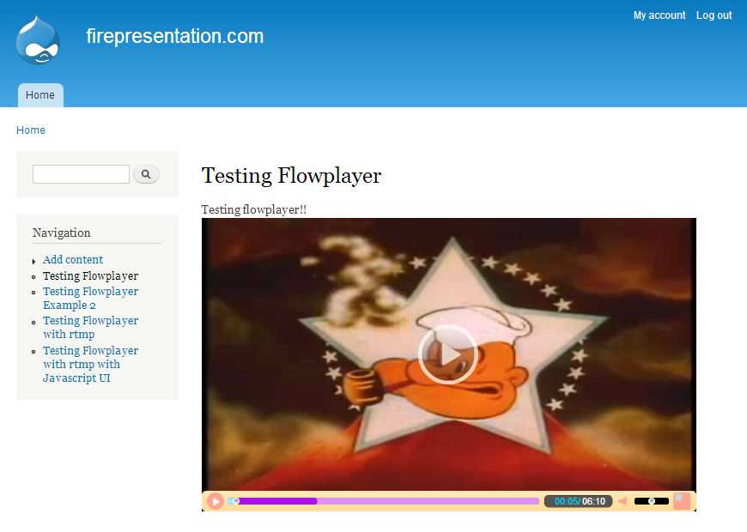
1) continued… (Custom Module with FP)
fp_example.inc
Add page content

Slide 5
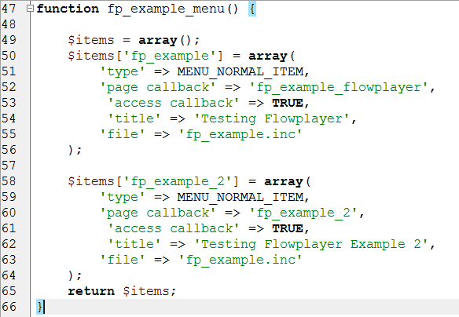
2) Let’s access Flowplayer directly
fp_example.module
Create a new Menu Item Callback for example 2

Slide 6
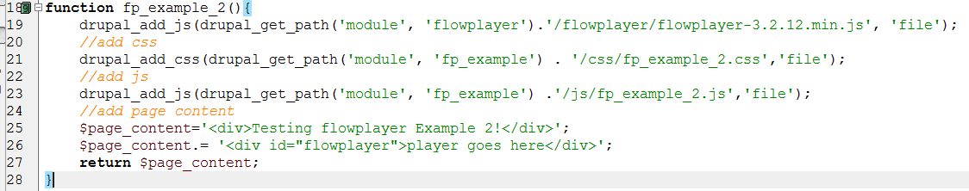

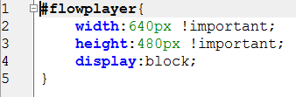
2) Continued (access FP directly)
fp_example.inc
Add your own javascript - to call flowplayer
fp_example_2.css
← Download Flowplayer Flash here
http://flash.flowplayer.org/download/

Slide 7
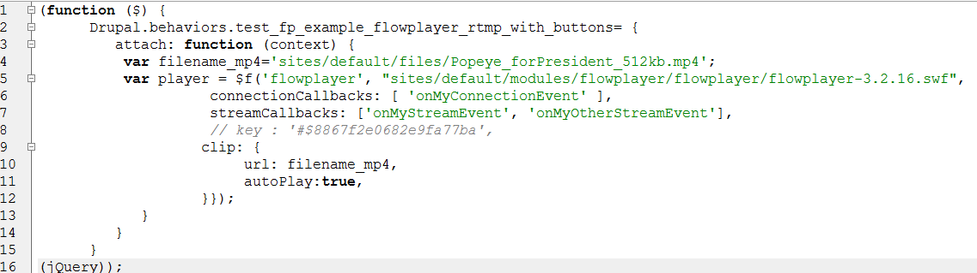
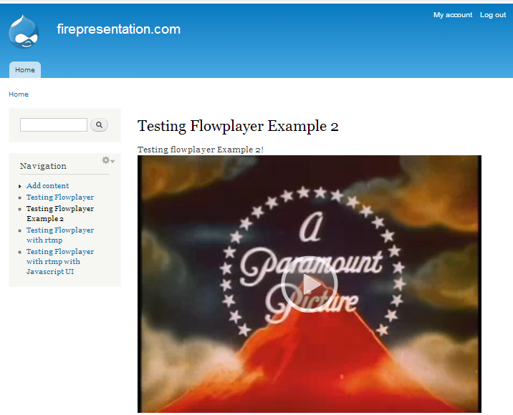
2) Continued (access FP directly)
/js/fp_example_2.js

Slide 8
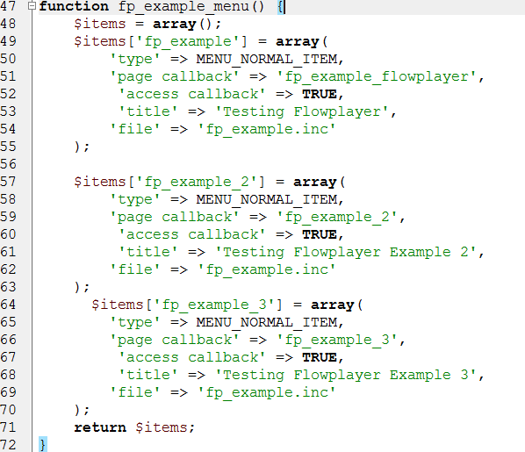
3) With RTMP
fp_example.module
Add a new menu callback for example 3

Slide 9
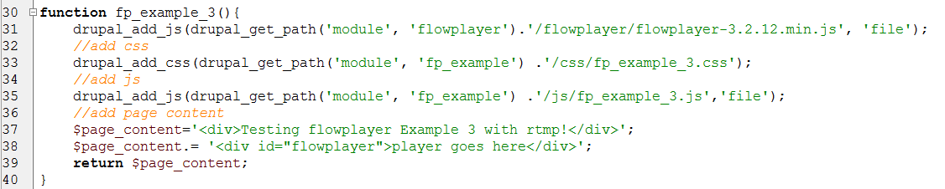
3) Continued… With RTMP
fp_example.inc
fp_example_3.css

Slide 10
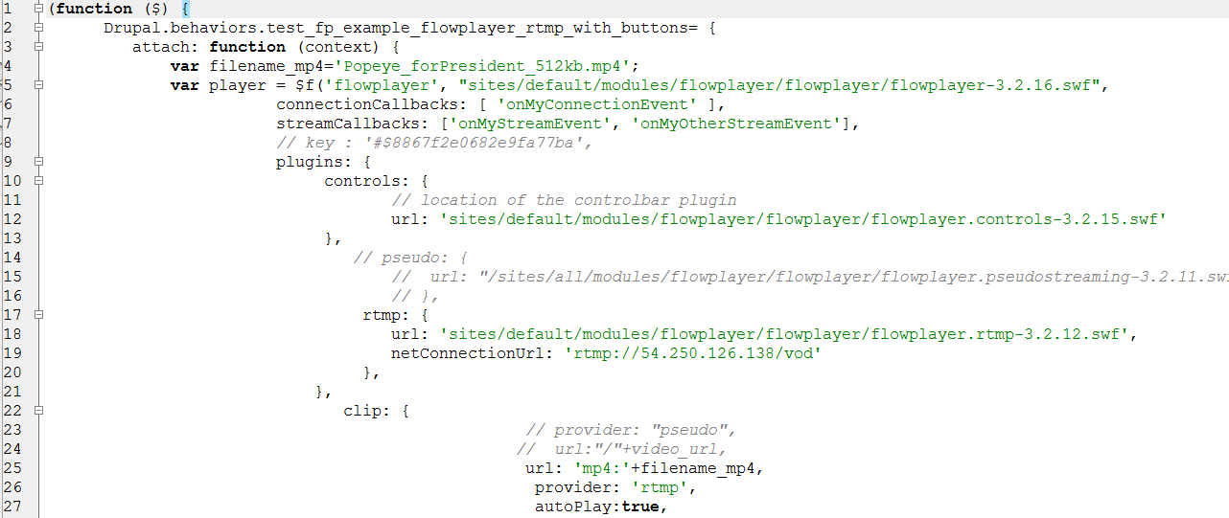
3) Continued… With RTMP
js/fp_example_3.js

Slide 11
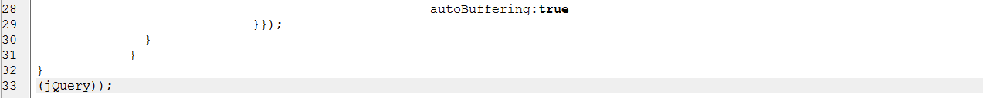
3) Continued… With RTMP
js/fp_example_3.js

Slide 12
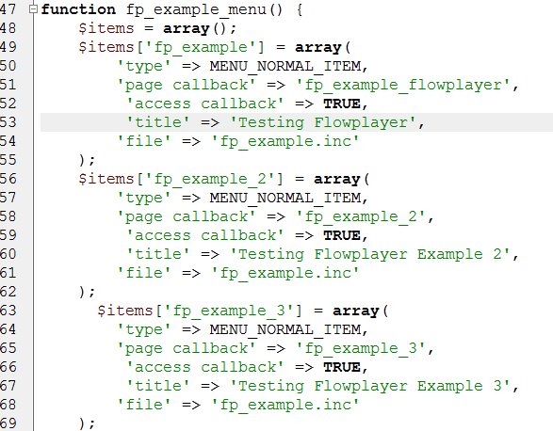
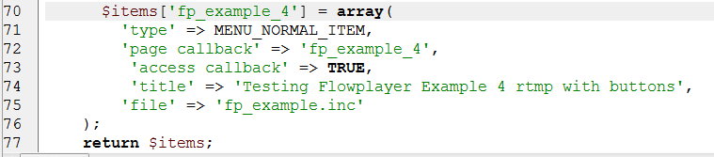
4) Javascript UI With RTMP
fp_example.module
Add a new menu callback for example 4

Slide 13
4) Continued Javascript UI With RTMP
fp_example.module
Add a new menu callback for example 4

Slide 14
4) Javascript UI With RTMP
css/fp_example_4.css
Made nice buttons etc

Slide 15

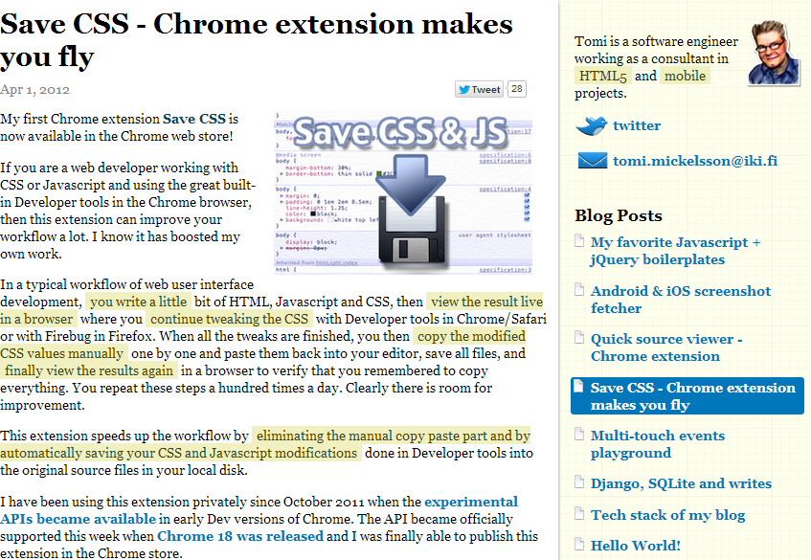
http://ow.ly/lBgJI
GREAT CSS Tool:

Slide 16
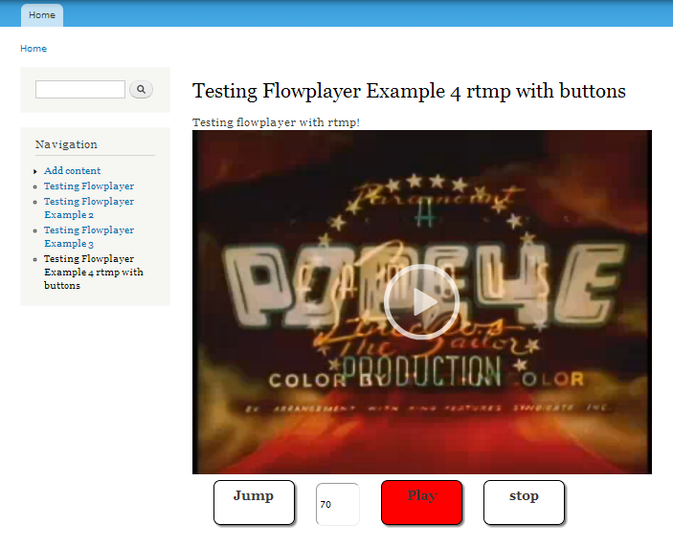
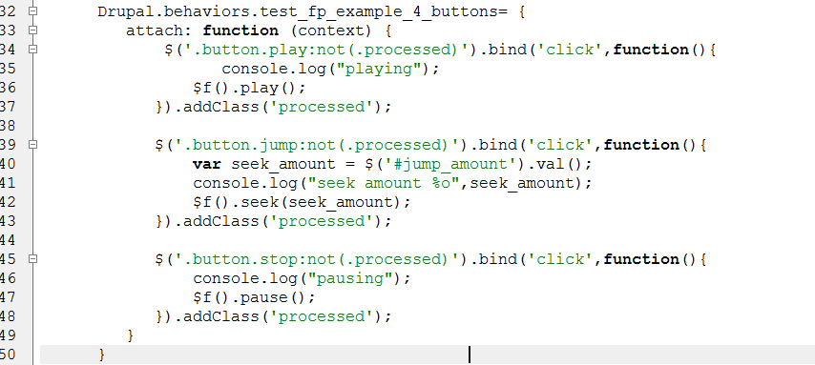
4) Javascript UI With RTMP
js/fp_example_4.js
Made nice buttons etc

Slide 17

Thankyou!
fire@b3dmultitech.com
Presented by Paul Preibisch
fire@b3dmultitech.com
Twitter: @fire

